Slide 1

Azure
Azure Training
Rainer Stropek
software architects gmbh
Web
Mail
Twitter
http://www.timecockpit.com
rainer@timecockpit.com
@rstropek
For Developers

Slide 2
Azure AppService

Slide 3
Overview Azure App Service
Hosting web applications, REST APIs, and mobile back ends
HTTP, HTTPS, WebSockets
Language- and Platform-agnostic
Windows, Linux
.NET, .NET Core, Node.js, Java etc.
PaaS and Serverless
Security, load balancing, autoscaling, and automated management built in
Azure Functions
When to use what?
https://docs.microsoft.com/en-us/azure/app-service/overview-compare

Slide 4
Overview Azure App Service
App Service Environment
Isolated to running only a single customer's applications
Deployed into a virtual network with VPNs to on-premises resources
https://docs.microsoft.com/en-us/azure/app-service/environment/intro
Pricing
https://azure.microsoft.com/en-us/pricing/details/app-service/windows/
Kudu: Engine behind App Service
https://github.com/projectkudu/kudu/wiki
Windows: Sandbox (https://github.com/projectkudu/kudu/wiki/Azure-Web-App-sandbox)

Slide 5
Configure
App Settings
https://docs.microsoft.com/en-us/azure/app-service/web-sites-configure
Node.js versioning: https://github.com/projectkudu/kudu/wiki/Node-versioning
New: Managed Identity
https://docs.microsoft.com/en-us/azure/app-service/overview-managed-identity
https://docs.microsoft.com/en-us/azure/app-service/app-service-key-vault-references

Slide 6

The Problem
Unsecure key storage
Plaintext is very common
Locally and in the cloud
Access keys for valuable resources, not just test env
Publish keys accidentally
E.g. checked in
Vulnerability from hackers and malicious insiders
Missing key rotation practices

Slide 7
Challenges
Scalability
Managing a large number of secrets
Large number of autonomous teams using heterogeneous technologies
Security
Secure storage and handling of secrets by default
Availability
Ensuring data accessibility for authorized users.
Governance
Access control
Auditing

Slide 8
Azure Key Vault
Centralized storage of secrets in Vaults
Controlled distribution
Monitor and log access to secrets and TLS certificates
Vaults = secure containers for secrets
Hardware Security Modules (HSMs)
Protected by Azure Active Directory
User accounts and service principles
Integrated with other Azure Services
E.g. Managed Service Identity
Read more in docs: https://docs.microsoft.com/en-us/azure/key-vault/

Slide 9
Managed Identity
Simplify handling secrets for Azure services
Creation, use, key rotation
Never store credentials in code or config
Integrated with Azure AD
Supports development and production
Use developer’s credentials during dev
Handle access credentials automatically in prod
Integrated with many Azure Services
Read more…
Here: Focus on Azure KeyVault integration

Slide 10
Tips
What if my environment doesn‘t support MSI (yet)?
Examples: Locally running Service Fabric, Azure Batch
Solution: Use a Service Principal (details)
User Assigned Identities
Currently in preview
Explicitly created (e.g. Azure CLI; details)
Can be assigned to multiple Azure service instances

Slide 11
Deployment Options
Options
ZIP: https://docs.microsoft.com/en-us/azure/app-service/deploy-zip
FTP: https://docs.microsoft.com/en-us/azure/app-service/deploy-ftp https://github.com/projectkudu/kudu/wiki/Accessing-files-via-ftp
CI/CD: https://docs.microsoft.com/en-us/azure/app-service/deploy-continuous-deployment https://github.com/projectkudu/kudu/wiki/Continuous-deployment
Git: https://docs.microsoft.com/en-us/azure/app-service/deploy-local-git
„Monaco“: https://github.com/projectkudu/kudu/wiki/App-Service-Editor
New: Run from Package (docs)

Slide 12
Deployment Options
Credentials
https://docs.microsoft.com/en-us/azure/app-service/deploy-configure-credentials
Staging Environments
https://docs.microsoft.com/en-us/azure/app-service/deploy-staging-slots
More information: https://github.com/projectkudu/kudu/wiki/Understanding-site-swaps

Slide 13
Authentication
Built-in authentication with AAD
https://docs.microsoft.com/en-us/azure/app-service/configure-authentication-provider-aad
https://docs.microsoft.com/en-us/azure/app-service/app-service-authentication-how-to
Identity Server
https://identityserver.io/
Auth0
https://auth0.com/

Slide 14
Management
Auto-Scaling
Prefer scale-out over scale-up
https://docs.microsoft.com/en-us/azure/azure-monitor/platform/autoscale-get-started
Logging
https://docs.microsoft.com/en-us/azure/app-service/troubleshoot-diagnostic-logs

Slide 15
Web Jobs
Run a program or script in the same context as a web app
Consider Azure Functions instead
https://docs.microsoft.com/en-us/azure/azure-functions/functions-compare-logic-apps-ms-flow-webjobs
Triggers and Bindings
https://docs.microsoft.com/en-us/azure/app-service/webjobs-sdk-get-started

Slide 16
Azure Storage

Slide 17
NoSQL vs. SQL
Relational (SQL)
Data stored in columns and tables
Relationships represented by data
Data Manipulation Language (DML)
Data Definition Language (DDL)
Transactions
Abstraction from physical layer
NoSQL
Non-relational
Key/value, documents, graph
Distributed
Often open-source
Horizontally scalable
Often schema-free
Often with easy replication support
Eventually consistent
BASE (not ACID)

Slide 18
Azure Storage

Slide 19
Azure Storage
Managed storage services for Azure apps
Blobs
Files
Queues
Tables
Azure Storage Explorer
https://azure.microsoft.com/en-us/features/storage-explorer/
Consider combination with Azure Search
https://docs.microsoft.com/en-us/azure/storage/blobs/storage-unstructured-search
https://docs.microsoft.com/en-us/azure/storage/common/storage-introduction

Slide 20
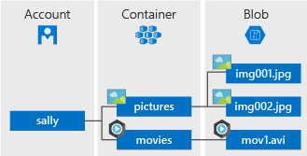
Blob Storage
Store unstructured data
Images, packages, videos, etc.
Block vs. Page Blobs (docs)
Static website hosting
https://docs.microsoft.com/en-us/azure/storage/blobs/storage-blob-static-website-host
Access
via API (https://docs.microsoft.com/en-us/azure/storage/common/storage-introduction#blob-storage)
via HTTP(S)
AzCopy (https://docs.microsoft.com/en-us/azure/storage/common/storage-use-azcopy-migrate-on-premises-data)
https://docs.microsoft.com/en-us/azure/storage/blobs/storage-blobs-overview

Slide 21
Authentication
Shared key
https://docs.microsoft.com/en-us/rest/api/storageservices/authorize-with-shared-key
Shared Access Signature
https://docs.microsoft.com/en-us/azure/storage/common/storage-dotnet-shared-access-signature-part-1
With AAD
https://docs.microsoft.com/en-us/azure/storage/common/storage-auth-aad

Slide 22
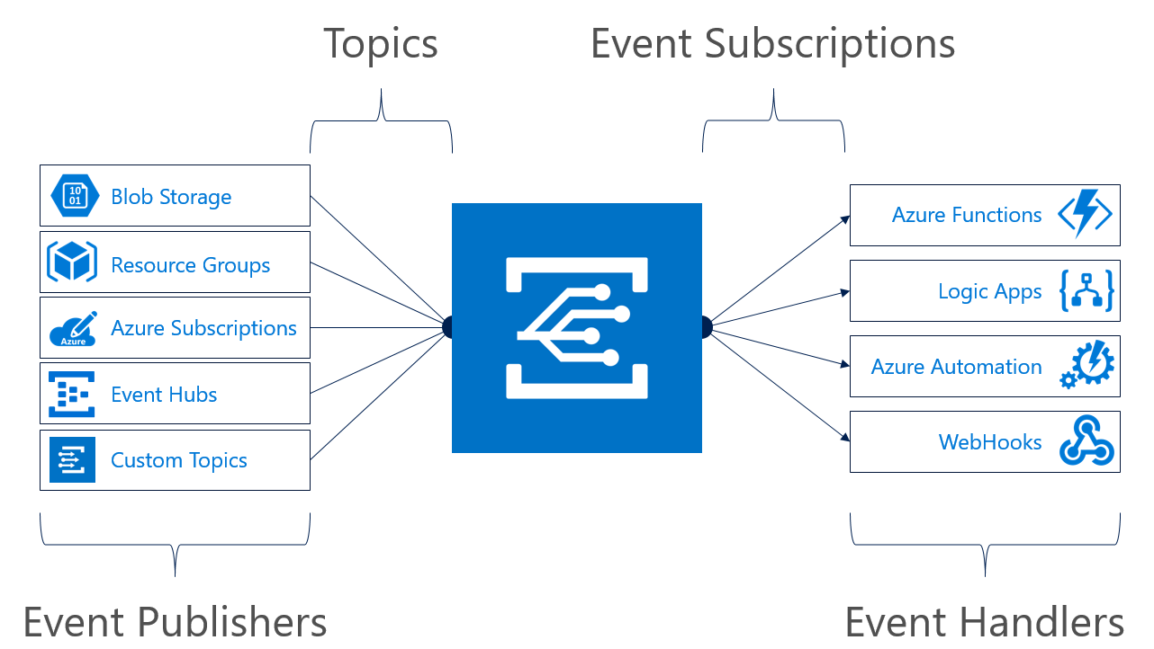
Events
Integration with Azure Event Grid
https://docs.microsoft.com/en-us/azure/storage/blobs/storage-blob-event-overview

Slide 23
Azure SQL Database

Slide 24


SQL Options in Azure
SQL Server
SQL Server in Azure VM
Azure
SQL Database
Azure SQL Data Warehouse
SQL
DW
Cloud-first but not cloud only
Docker Container Support
Windows and Linux

Slide 25
Azure SQL Database
Fully managed SQL database service that lets you focus on your business
Azure
SQL Database
Database provisioning on-demand
Predictable performance for enterprise workloads
Elastic database pools for unpredictable SaaS workloads
99.99% availability SLA
Geo-replication and restore services for data protection
Secure and compliant to protect sensitive data
SQL

Slide 26
Predictable performance
Isolated databases are allocated isolated resources
Basic, Standard, and Premium tiers provide increasing performance levels
Scale up/down in response to actual or predicted change in workload
Databases remain online while scaling
Hourly billing at highest rate that hour
P11
P6
P4
P2
P1
S3
S2
S0
S1
B
5
10
20
50
100
125
250
500
1000
1750
DTUs

Slide 27
Elastic database pools
Share resources dynamically among databases on the same server
Customer-managed over-provisioning makes pools cost-effective for unpredictable, sporadic workloads
Well-matched to many database-per-tenant SaaS workloads
Basic, Standard, and Premium tiers
Databases can burst to the same level as isolated DBs in the same tier
Pool size is scaled to support aggregate workload
Hourly billing for the pool based on pool size and DB count
Max per-database burst level
eDTUs
200
400
800
1200

Slide 28
Azure Cosmos DB

Slide 29
Developing planet-scale apps comes with planet-scale challenges
Write accurate, globally distributed apps
Managing and versioning complex schemas
Scaling both throughput and storage based on global demand
Balancing the needs for strong and eventual consistency
Delivering highly-responsive experiences
Ensuring an always-on system

Slide 30

Put your data where your users are

Slide 31
Introducing Azure Cosmos DB A globally distributed, massively scalable, multi-model database service
Global Business
Save money
Global distribution
Become more productive
Become more flexible
Elastic scale-out
Become more responsive
Guaranteed single-digit latency
Become more innovative
Choice of consistency
Supplier
Enterprise-level SLAs
Store
Multi-model + multi API
Partner

Slide 32



Introducing Azure Cosmos DB A globally distributed, massively scalable, multi-model database service
Table API
Column-family
Document
Key-value
Graph
Elastic scale out
of storage & throughput
Guaranteed low latency at the 99th percentile
Five well-defined consistency models
Turnkey global distribution
Comprehensive SLAs

Slide 33
Azure DevOps

Slide 34


The converged DevOps lifecycle
Plan + Track
Release
Developers
IT Ops
Develop + Test
Monitor + Learn

Slide 35
Shift to DevOps
Old World
Focus on planning
Compete, not collaborate
Static hierarchies
Individual productivity
Efficiency of process
Assumptions, not data
New World
Focus on delivering
Collaborate to win
Fluent and flexible teams
Collective value creation
Effectiveness of outcomes
Experiment, learn and respond

Slide 36
DevOps habits and practices
PRACTICES
Application Performance Management
Infrastructure as Code
Continuous Deployment
Release Management
Configuration Management
Automated Recovery
PRACTICES
Automated Testing
Continuous Integration
Continuous Deployment
Release Management
PRACTICES
Usage Monitoring
Telemetry Collection Testing in Production
Stakeholder Feedback
PRACTICES
Code Reviews
Automated Testing
Continuous Measurement
FLOW OF CUSTOMER VALUE
TEAM AUTONOMY & ENTERPRISE ALIGNMENT
BACKLOG refined with LEARNING
EVIDENCE gathered in PRODUCTION
MANAGED TECHNICAL DEBT
PRODUCTION FIRST MINDSET
INFRASTRUCTURE is a FLEXIBLE RESOURCE
PRACTICES
Testing in Production
Usage Monitoring
User Telemetry
Stakeholder feedback
Feature flags
PRACTICES
Application Performance Management
Infrastructure as Code
Continuous Delivery
Release Management
Configuration Management
Automated Recovery
PRACTICES
Enterprise Agile
Continuous Integration
Continuous Deployment
Release Management

Slide 37
CI/CD in the Microsoft Universe

Slide 38
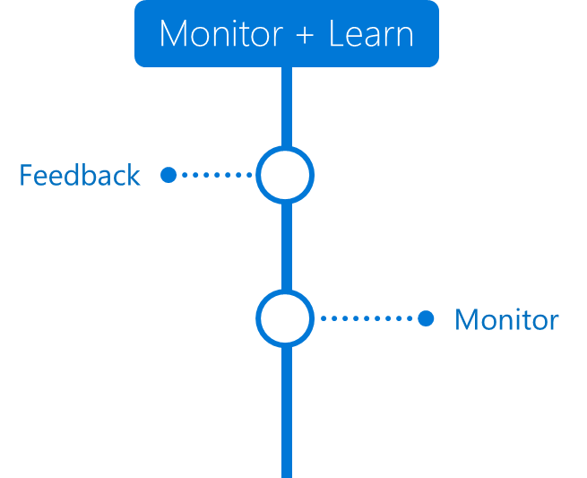

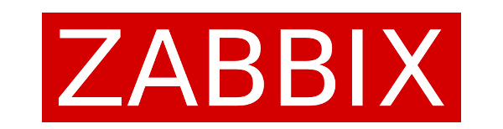




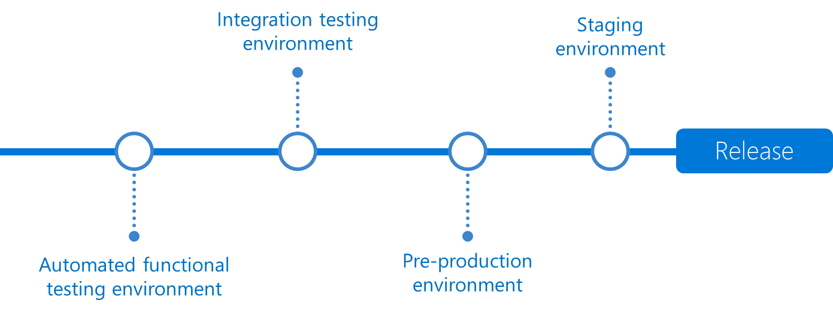




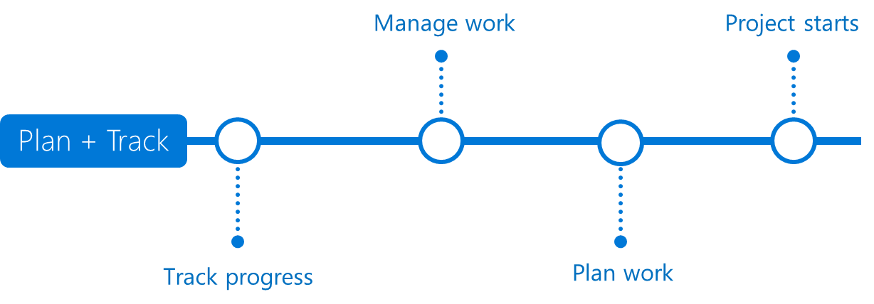








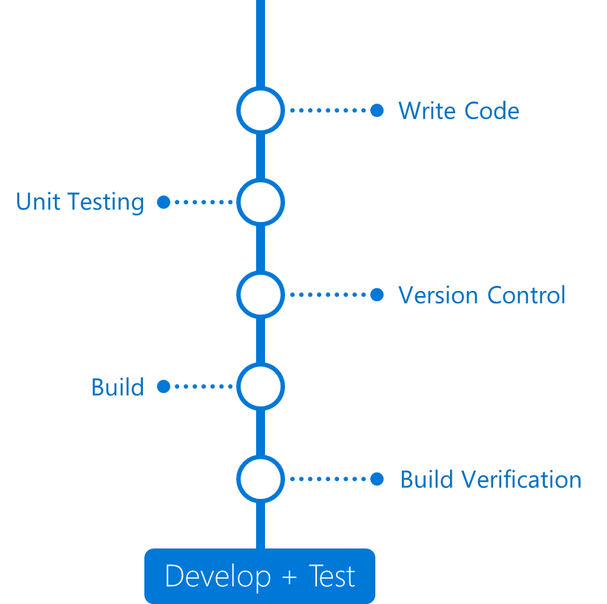

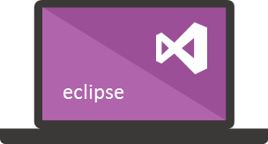
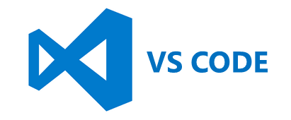


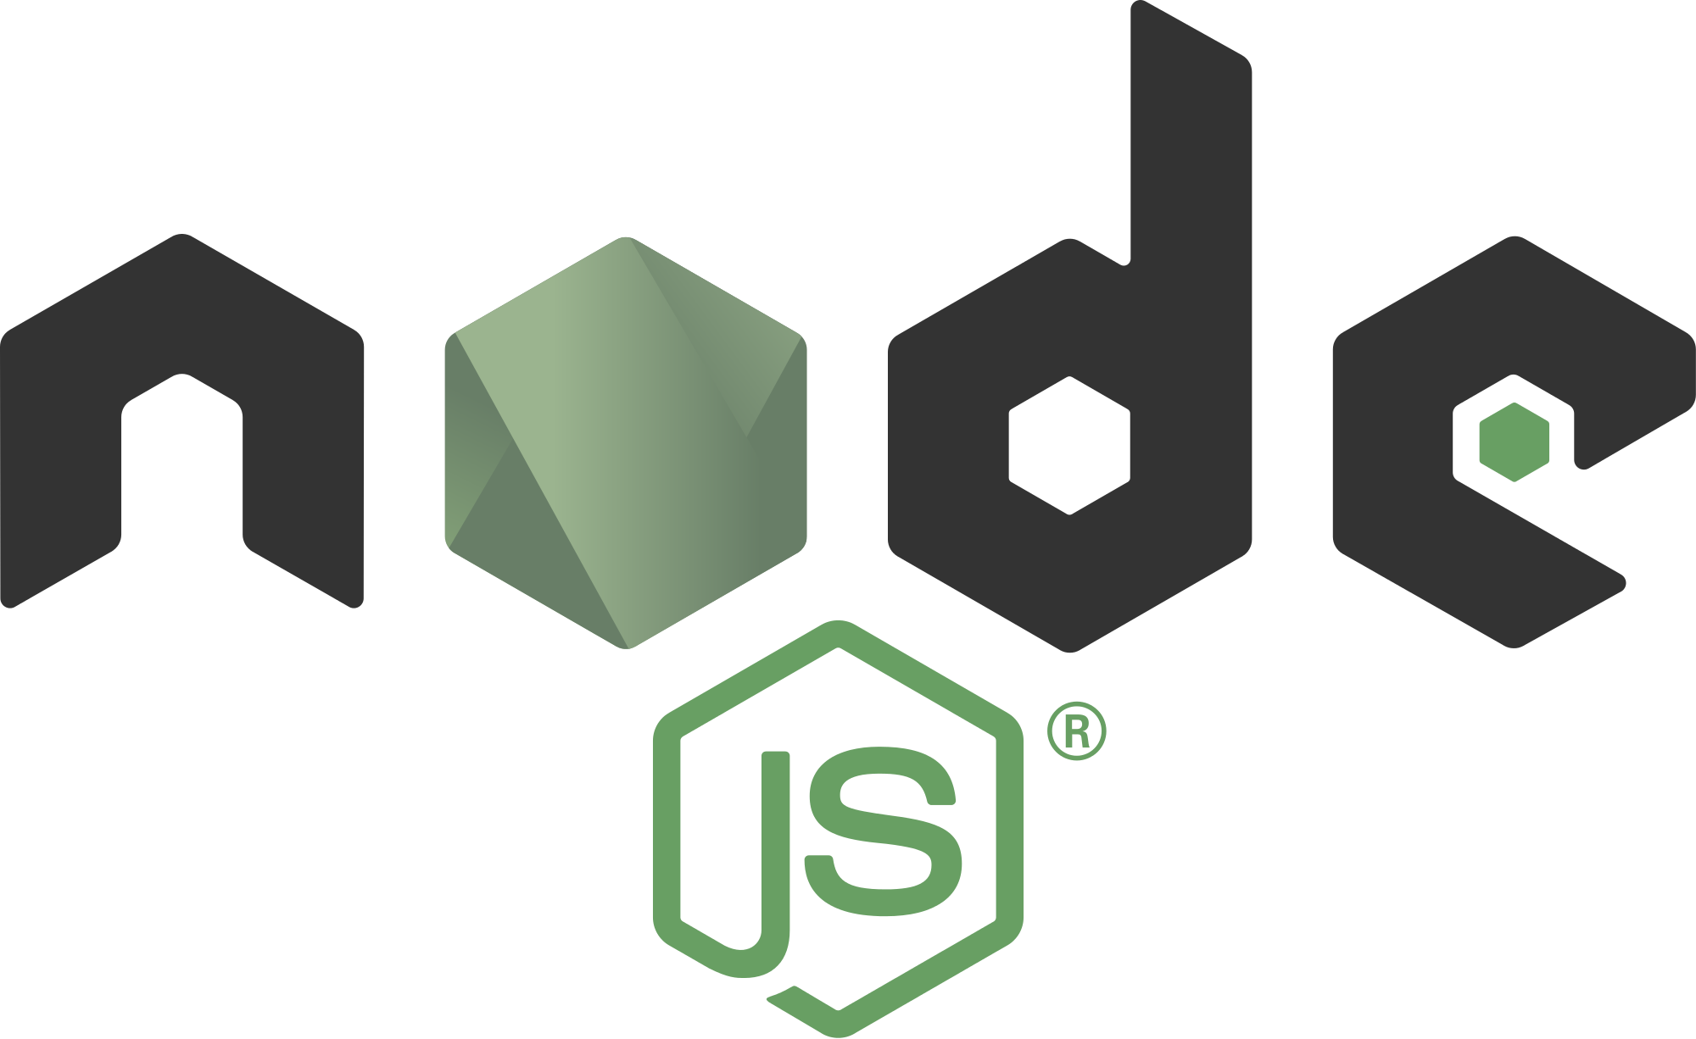
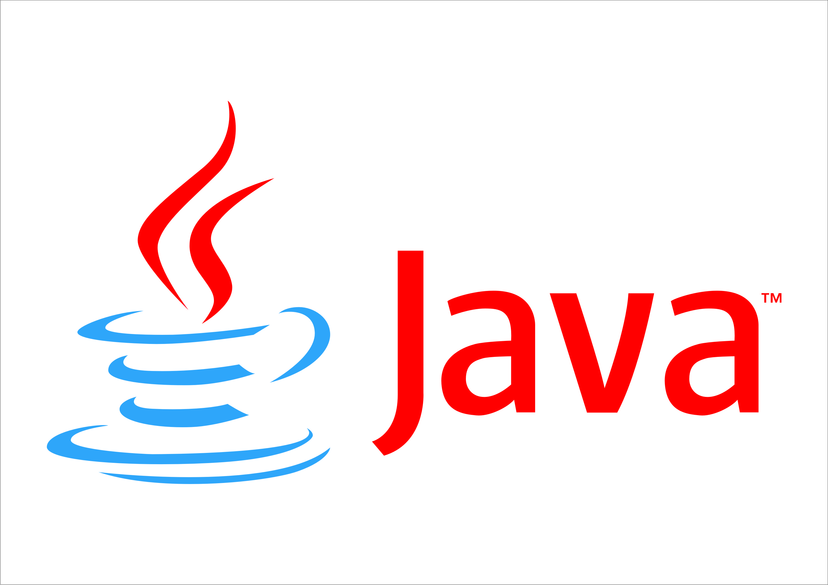

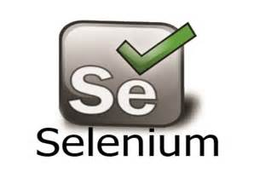





DevOps
(MS embraces 3rd party / OSS tools)
Azure Resource Management
VS Team Services (“VSTS”) + MS tools can handle the whole DevOps process or VSTS can orchestrate other (3rd party/OSS) tools.
DevOps
DevOps
Visual Studio
Where containers play biggest role
Notes:
DevOps is the union of people, process, and products to enable continuous delivery of value to end users.
The contraction of Dev and Ops refers to replacing silo’ed Development and Operations to create multidisciplinary teams that now work together with shared and efficient practices and tools.
Essential DevOps practices include CLICK
agile planning, CLICK
continuous integration, CLICK
continuous delivery, CLICK
and monitoring of applications.
CLICK DevOps becomes reality with powerful tools that help development teams move through the different phases of the DevOps lifecycle quickly and efficiently.
There are many powerful best-of-breed point solutions – both OSS and commercial – available today.
These tools cover individual DevOps tasks or entire phases, and teams choose and integrate their preferred tools in order to get an end-to-end toolchain that works for them.
CLICK Visual Studio Team Services (VSTS) is our Azure OSS DevOps solution and it is an easy and flexible offering.
It’s enterprise class, integrated from end to end, extensible, and works with other tools.
It ties everything together – program in any language, develop on any operating system, and deploy to any platform.
It’s best with Azure, but it integrates with other cloud providers, giving users the flexibility to explore and gradually move to Azure.
We do not ask you to stop promoting your favorite OSS DevOps tools – quite the opposite, we want your customers move the tools they are using to Azure.
However, we do want you to keep in mind that VSTS is a great integration platform that can work with your OSS tool of choice and also brings additional value if you include it as part of an existing OSS DevOps setup.
How? Let’s take Jenkins as an example.
Jenkins is a great tool and best-of-breed OSS solution. Jenkins runs on Azure, in fact you can provision a fully functional Jenkins instance in just a few minutes from the Azure portal. That’s a great start and will create some consumption.
But Jenkins also has some drawbacks from past experience:
Managing Jenkins infrastructure can be cumbersome. It requires a master/slave relationship between all build nodes. As a team grows, they will require more builds which in turns requires more build nodes. From an infrastructure perspective, you need a dedicated team to manage that whole setup to ensure it runs smoothly.
Security within Jenkins is enforced via plugins and highly complex to setup (when compared to VSTS).
The plugin ecosystem is wide but there a lot of plugins that cause stability issues within Jenkins.
Upgrading Jenkins is very painful which results in more teams using outdated version of Jenkins which can cause security risks.
Integrating Jenkins with other tools like Jira or Github is cumbersome (while VSTS provides features from all tools within one product).
If a Jenkins setup is mission-critical then setting up Jenkins in HA is extremely hard considering its backend is a filesystem rather than a database. Consequently, teams will tend to scale the Jenkins master vertically instead of horizontally as the number of jobs increases. The on-premises team is responsible to provide a decent SLA to the dev/ops teams.
This is not to say that teams should stop using Jenkins – but they should be aware how VSTS can help mitigate some of the drawbacks.
This was just an example of one tool in an end-to-end DevOps toolchain.
If your customer is using multiple different tools, similar issues will crop up every time.

Slide 39







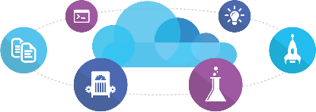

Microsoft Tooling
People | Process | Tools
Developer IDE
Build/CI
Release/CD
Develop
Build + Test
Monitor
Deploy
Team Collaboration
Release Management for Visual Studio
Test
Monitor + Learn
Automation Service
PowerShell | WAML
Azure Resource Management
Application Insights
Microsoft Test Manager
xPlat Command Line
On-Premises | Hybrid | Cloud

Slide 40








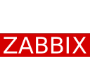





OSS Tooling
People | Process | Tools
Developer IDE
Build/CI
Configuration
Develop
Build + Test
Monitor
Deploy
Team Collaboration
Release
Monitor + Learn
Test
On-Premises | Hybrid | Cloud

Slide 41
DevOps with ARM

Slide 42
Consistent Management Layer
Azure Resource Manager API

Slide 43
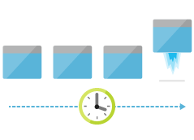
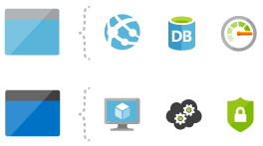

Areas of Focus
Deploy
Organize
Control

Slide 44
Deploying with ARM
template-driven
declarative
idempotent
multi-service
multi-region
extensible

Slide 45
Support for IaaS and PaaS
Support for IaaS
Incl. Networking
Support for PaaS
Mixed environments
E.g. web app in IaaS, SQL DB in PaaS

Slide 46
Advanced Concepts, Resources
Template functions
E.g. string functions, numeric functions, array functions, deployment values, etc.
https://azure.microsoft.com/en-us/documentation/articles/resource-group-template-functions/
Template linking
https://azure.microsoft.com/en-us/documentation/articles/resource-group-linked-templates/
Creating multiple instances
https://azure.microsoft.com/en-us/documentation/articles/resource-group-create-multiple/
Best Practices
https://azure.microsoft.com/en-us/documentation/articles/best-practices-resource-manager-design-templates/
Reference Secrets in KeyVault
https://docs.microsoft.com/en-us/azure/azure-resource-manager/resource-manager-keyvault-parameter#reference-secrets-with-static-id

Slide 47
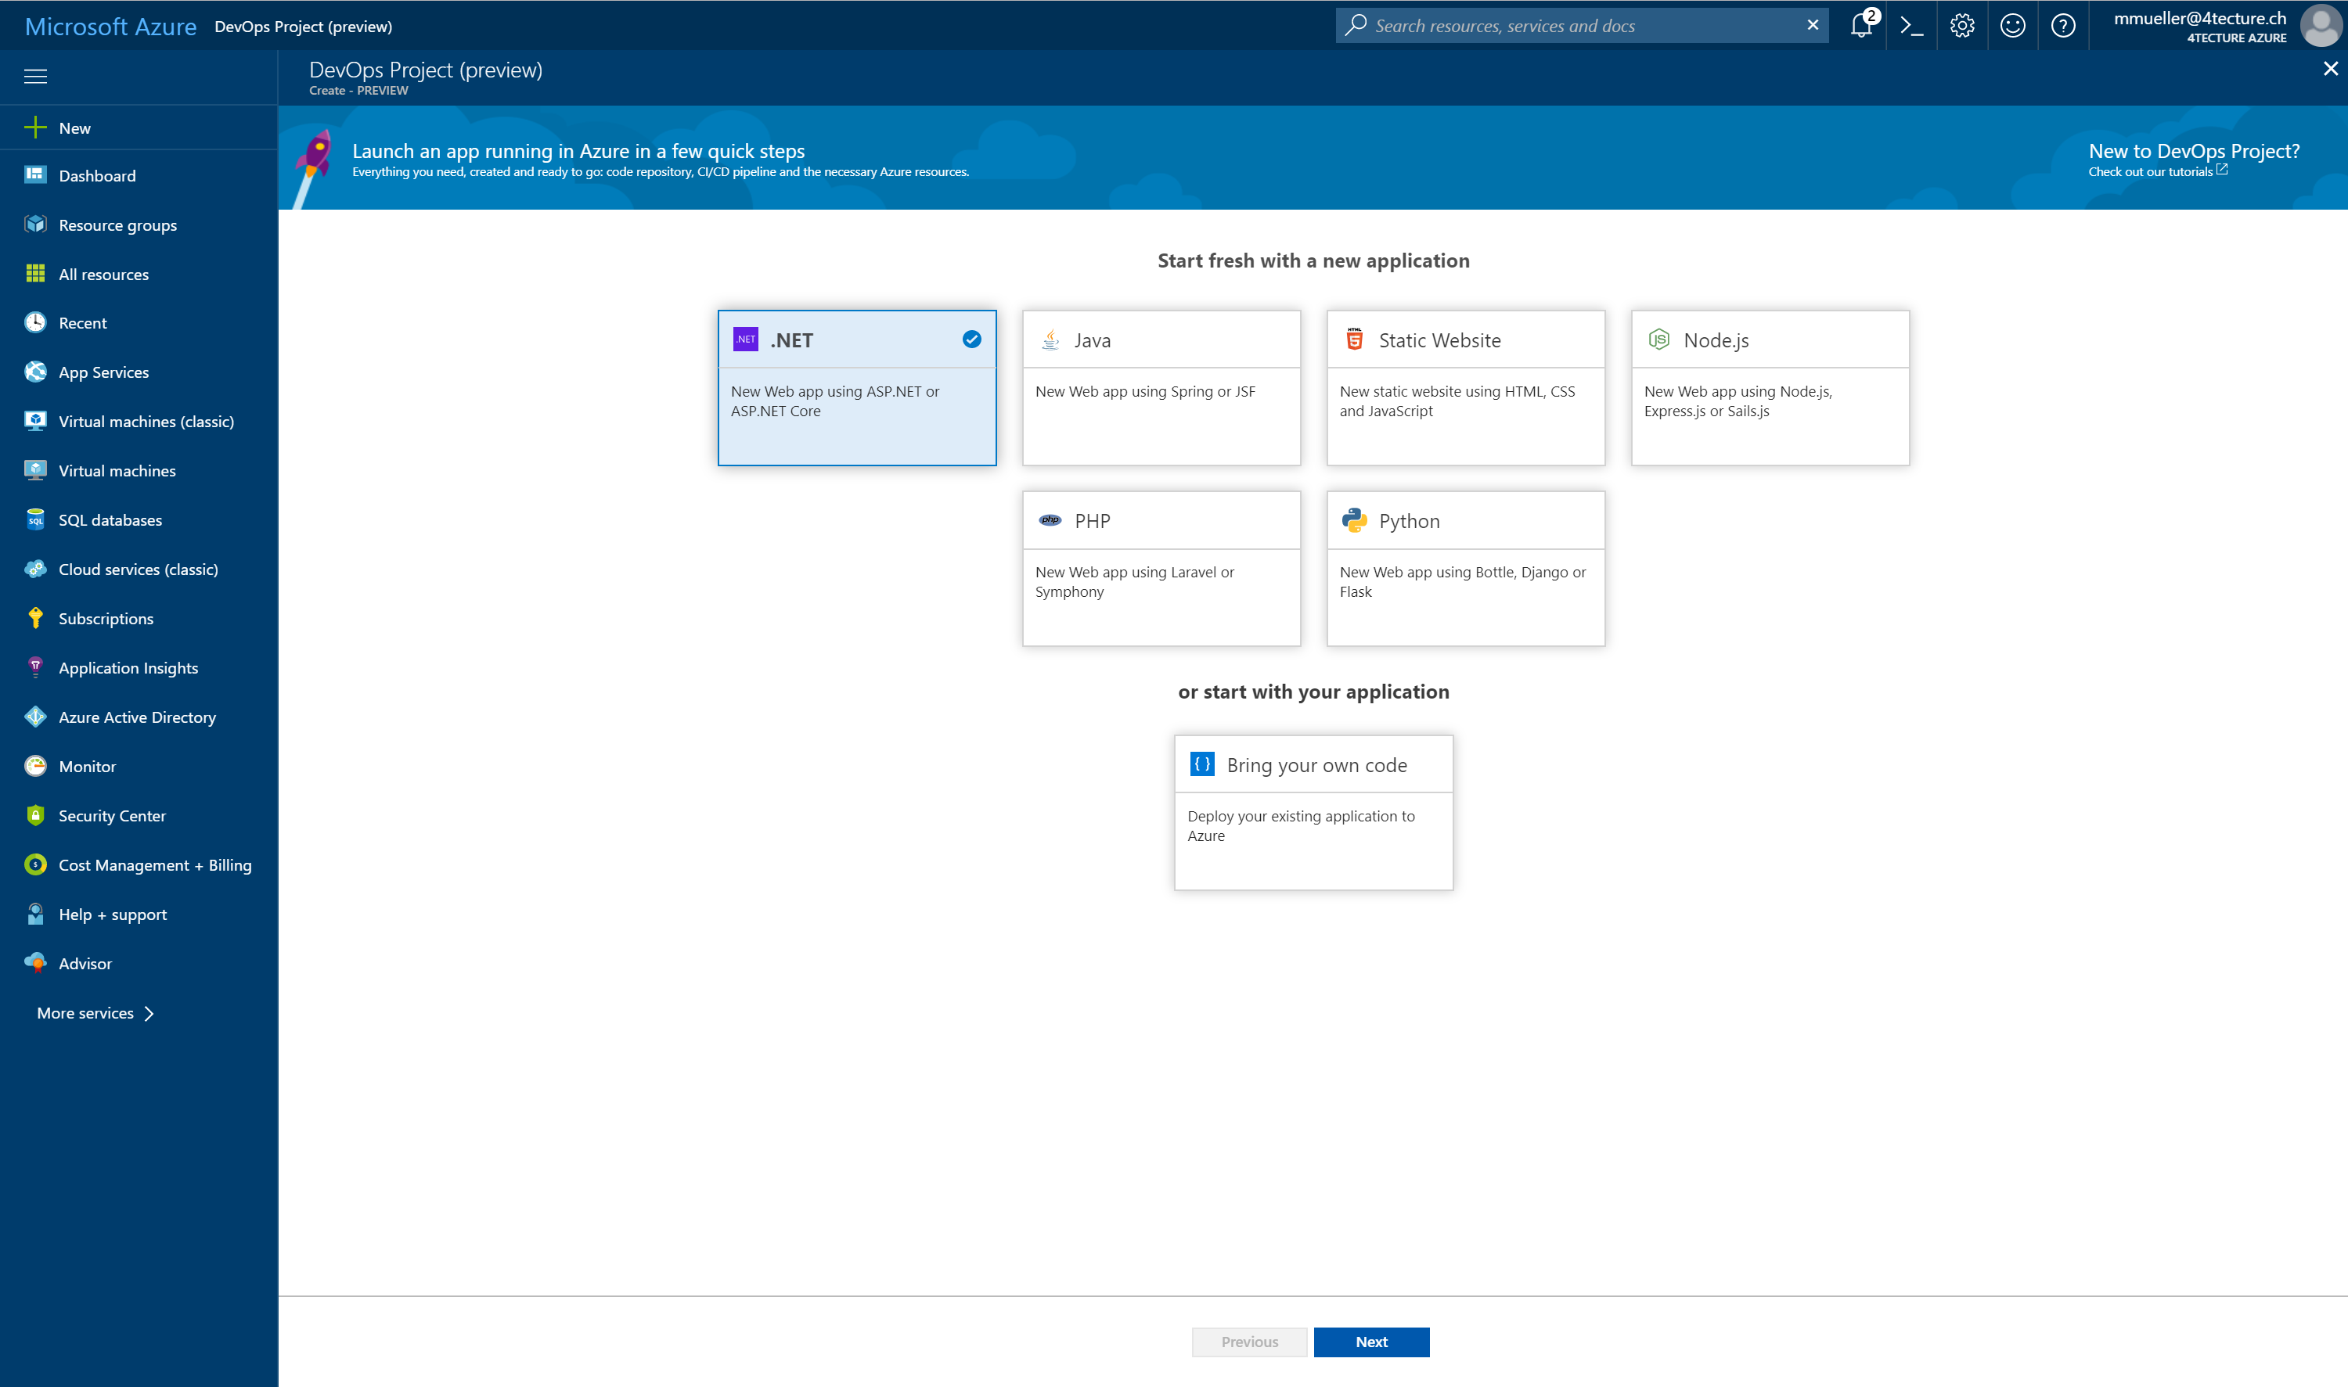
Azure DevOps Project
https://azure.microsoft.com/en-us/features/devops-projects/

Slide 48
Azure DevOps Pipelines
CI/CD Service
Various sources
GitHub, GitLab, Bitbucket, Azure Repos
Language- and platform agnostic
E.g. https://docs.microsoft.com/en-us/azure/devops/pipelines/languages/dotnet-core
Key Concepts
https://docs.microsoft.com/en-us/azure/devops/pipelines/get-started/key-pipelines-concepts

Slide 49
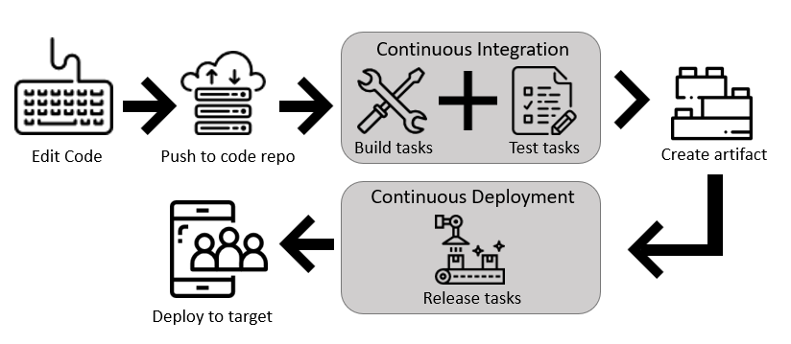
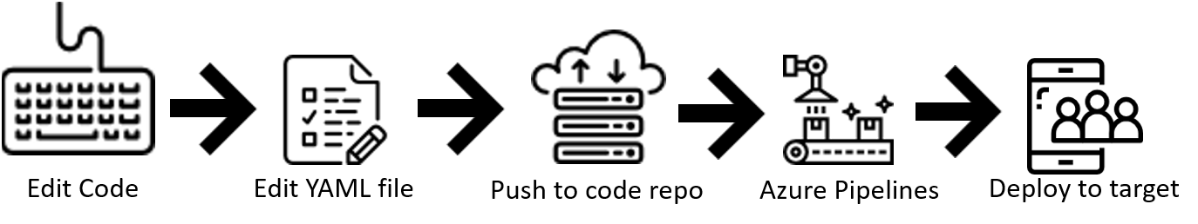
Azure DevOps Pipelines
https://github.com/MicrosoftDocs/pipelines-dotnet-core/blob/master/azure-pipelines.yml

Slide 50
Q&A
Azure Training
Rainer Stropek
software architects gmbh
Mail Web Twitter
rainer@timecockpit.com http://www.timecockpit.com @rstropek
Thank your for coming!

